Slide 1
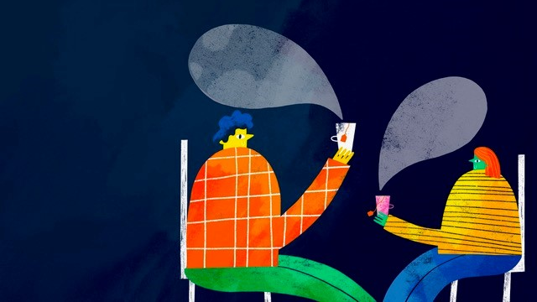

LET’S
TACKLE GAMBLING ADDICTION TOGETHER
GBG Land-Based Responsible Gambling Group Meeting
July 2023

Slide 2

One Man’s Vision
2021 marked 50 years of Gordon Moody providing treatment for those whose lives have been severely affected by gambling addiction.
Gordon House, as it was known then, was first opened in South London in 1971 by the Reverend Gordon Moody.

Slide 3
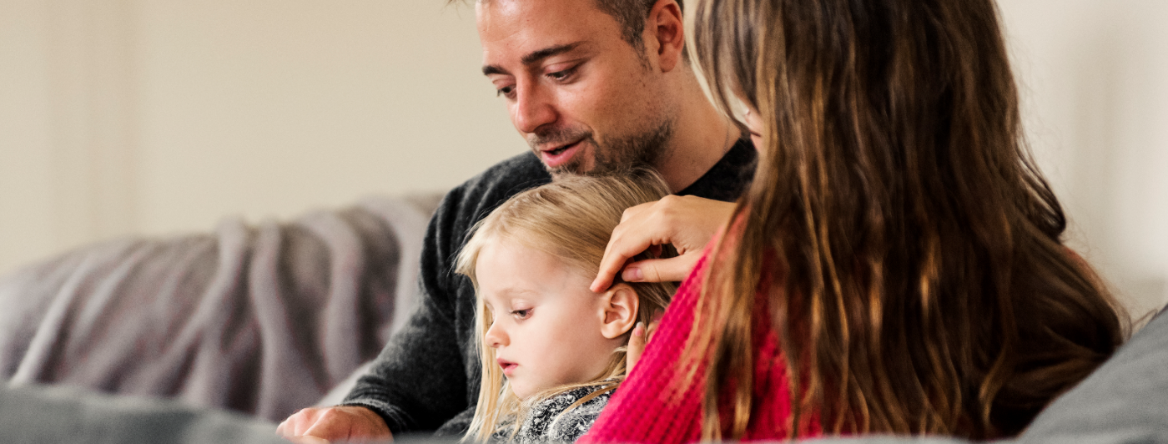
Our Vision
To enable all those affected by gambling related harm to have access to the right help at the right time

Slide 4
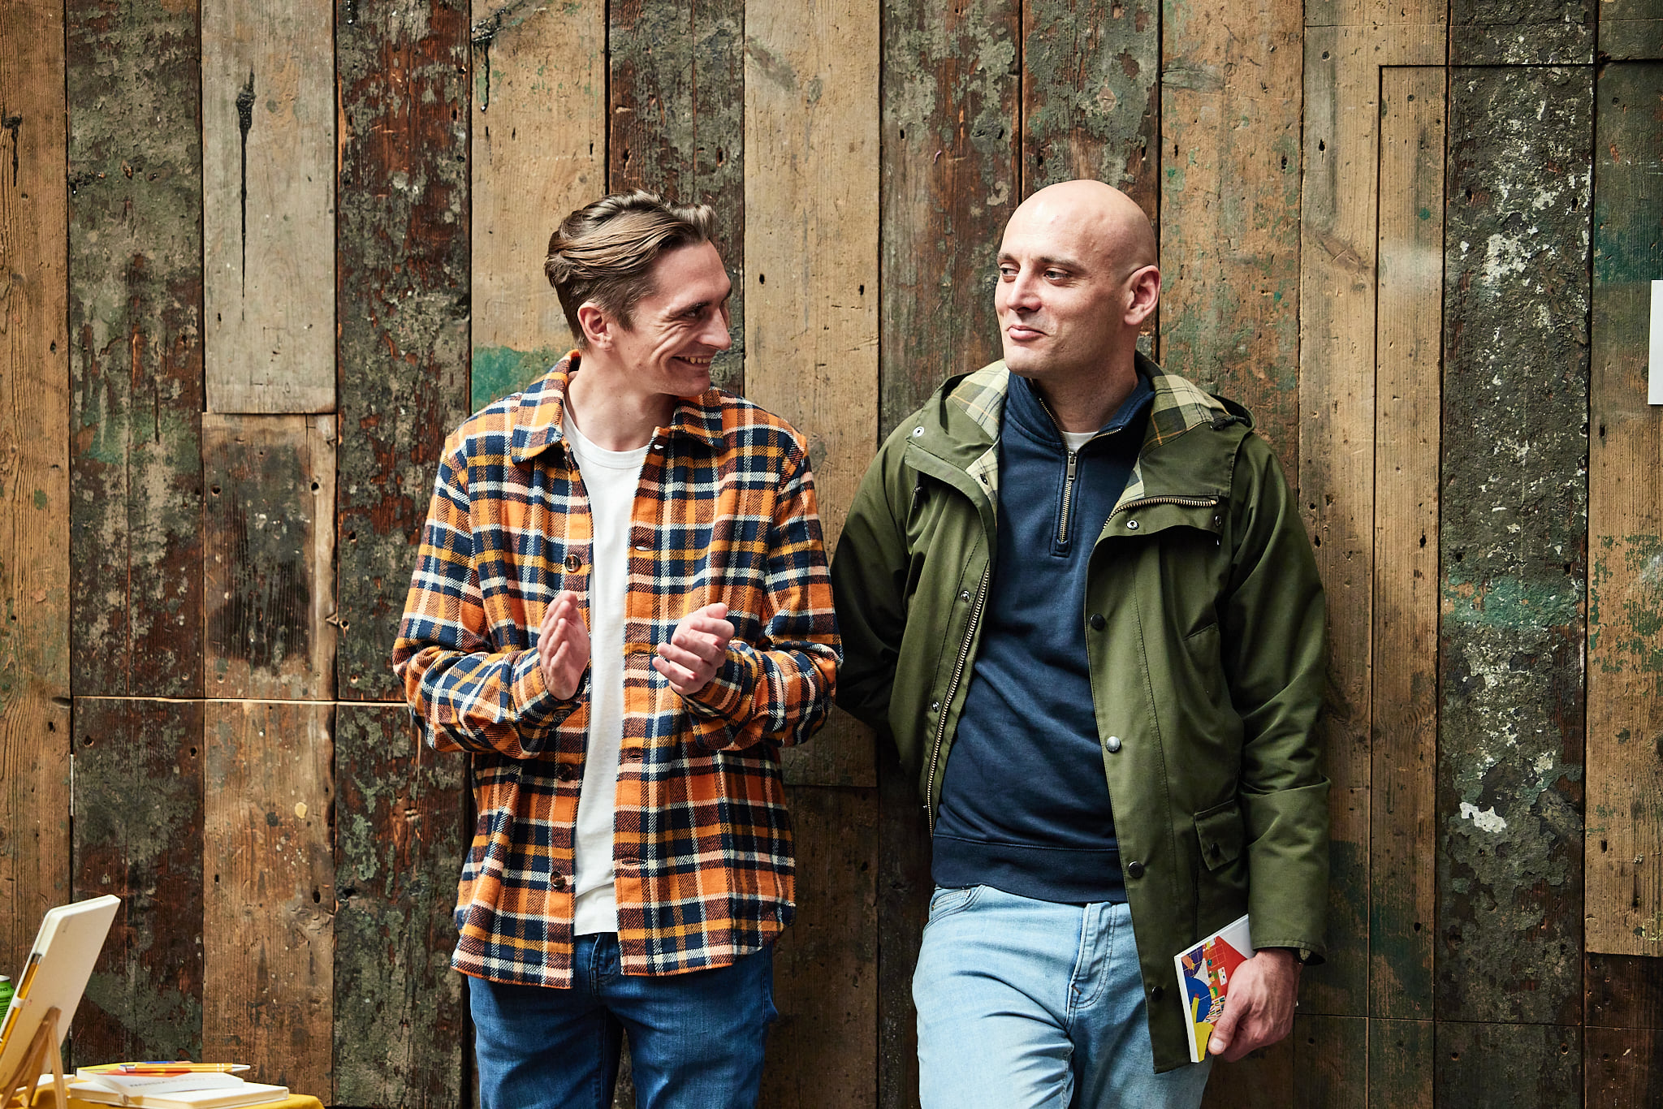
Our Purpose
To help people reclaim and rebuild their lives free from gambling addiction

Slide 5
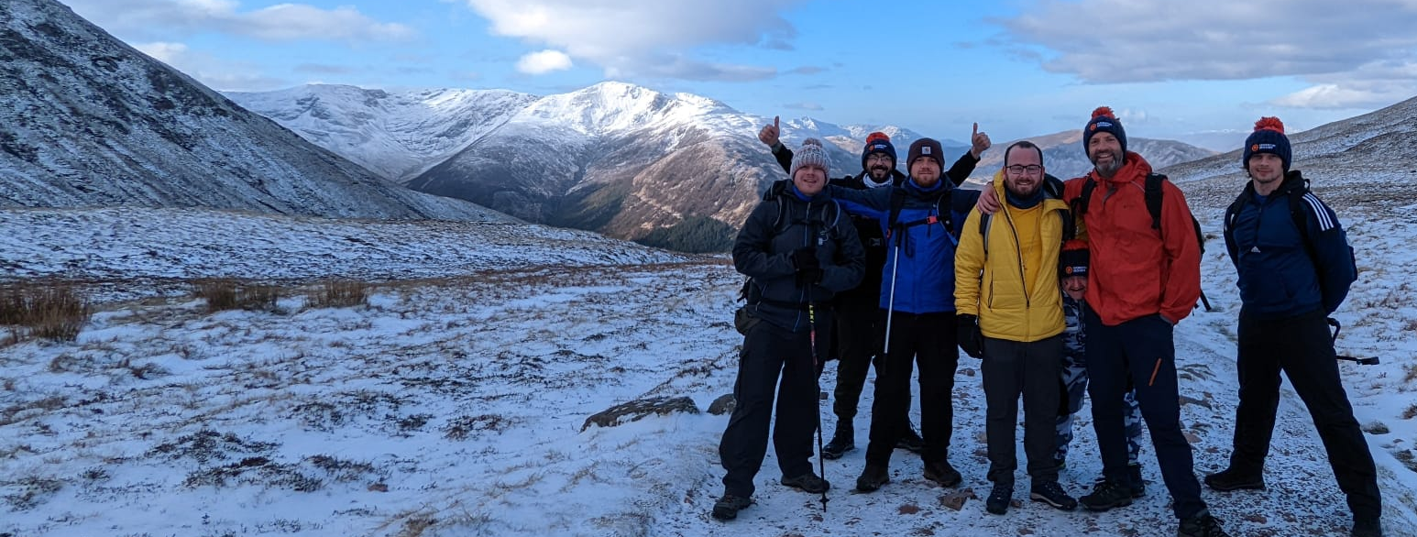
Our Mission
To be the benchmark for successfully treating people with the most severe gambling addictions

Slide 6
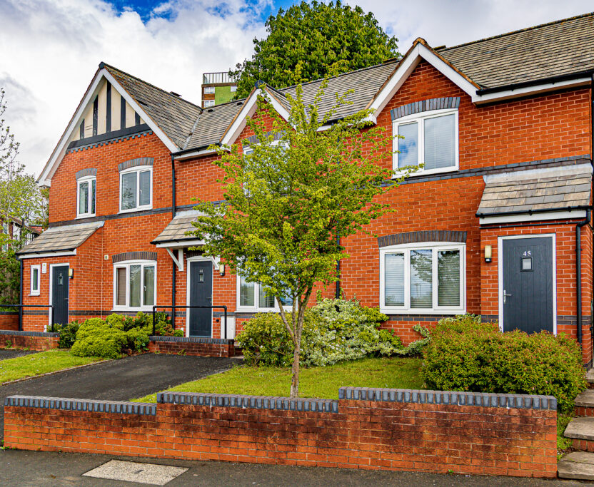
About Gordon Moody
  Founded in 1971, Gordon Moody has provided treatment for those severely affected by gambling harm for over 50 years.
  With residential treatment facilities, a Retreat & Counselling Programme, and space for complex cases, we provide effective treatment in a safe supported environment.
  Our comprehensive wraparound services ensure that those who reach out to Gordon Moody get the help and support they need to reclaim and rebuild their lives free from gambling addiction.
  We have 270 treatment spaces.
  We support those most severely affected by gambling addiction.

Slide 7
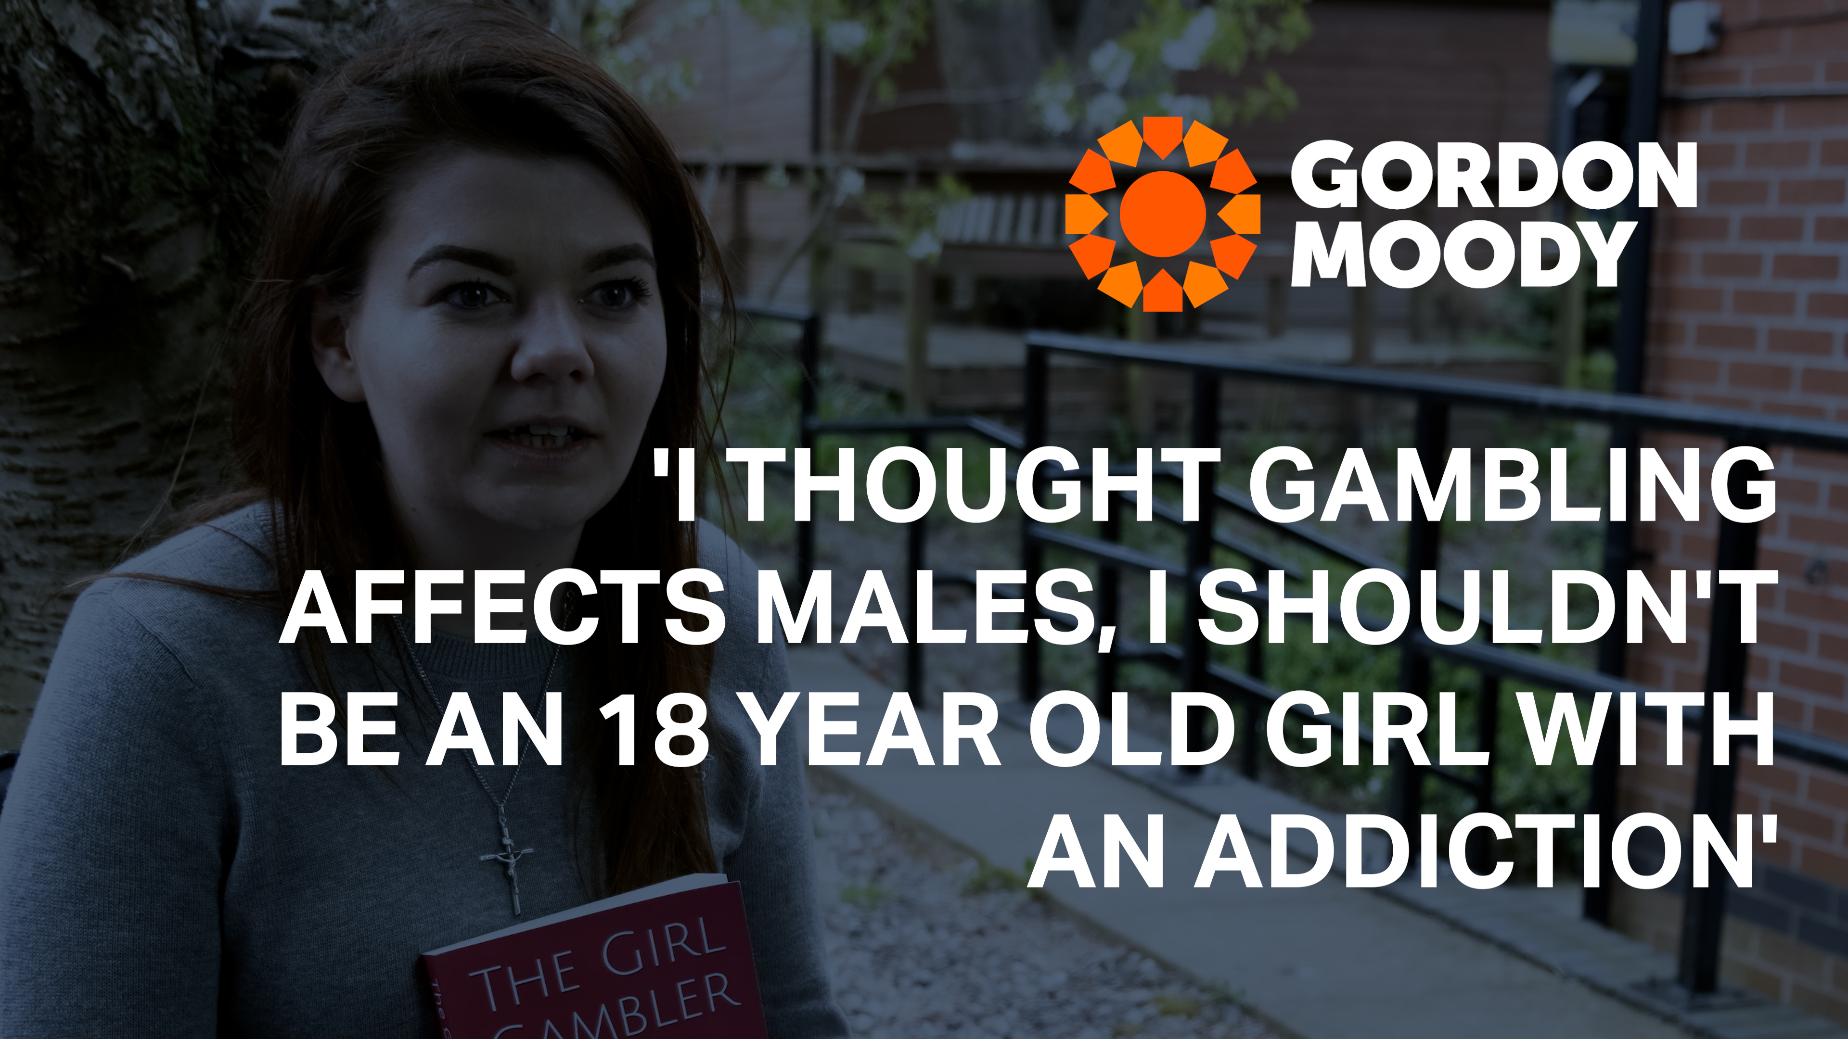
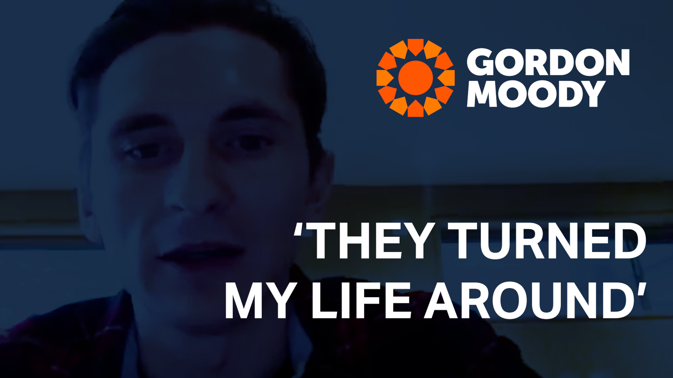
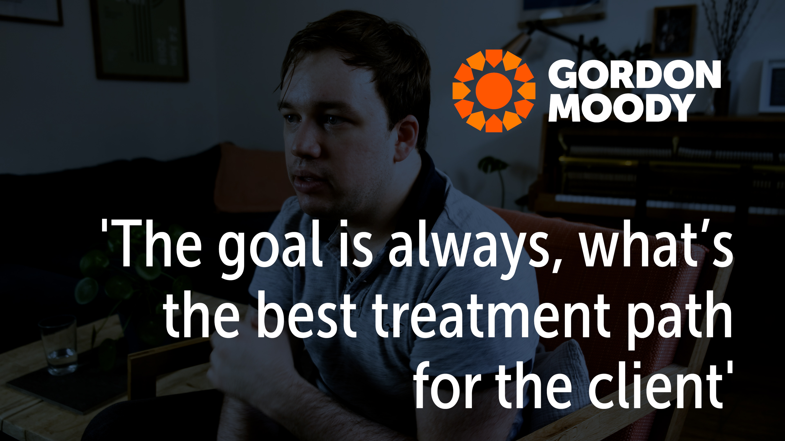
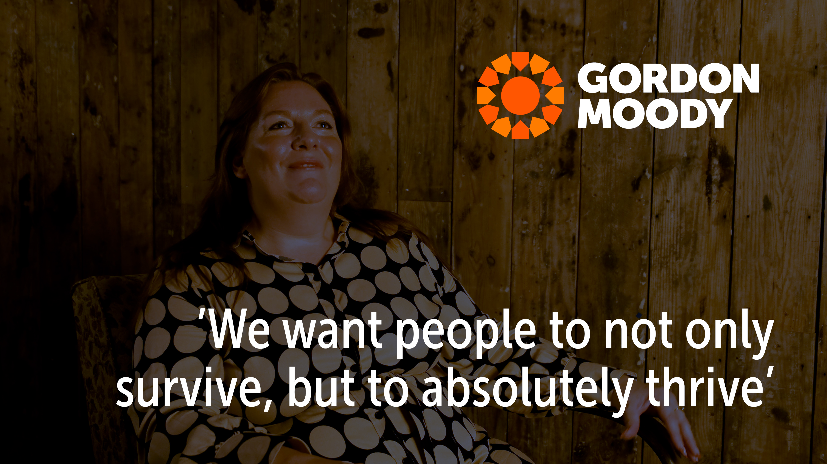
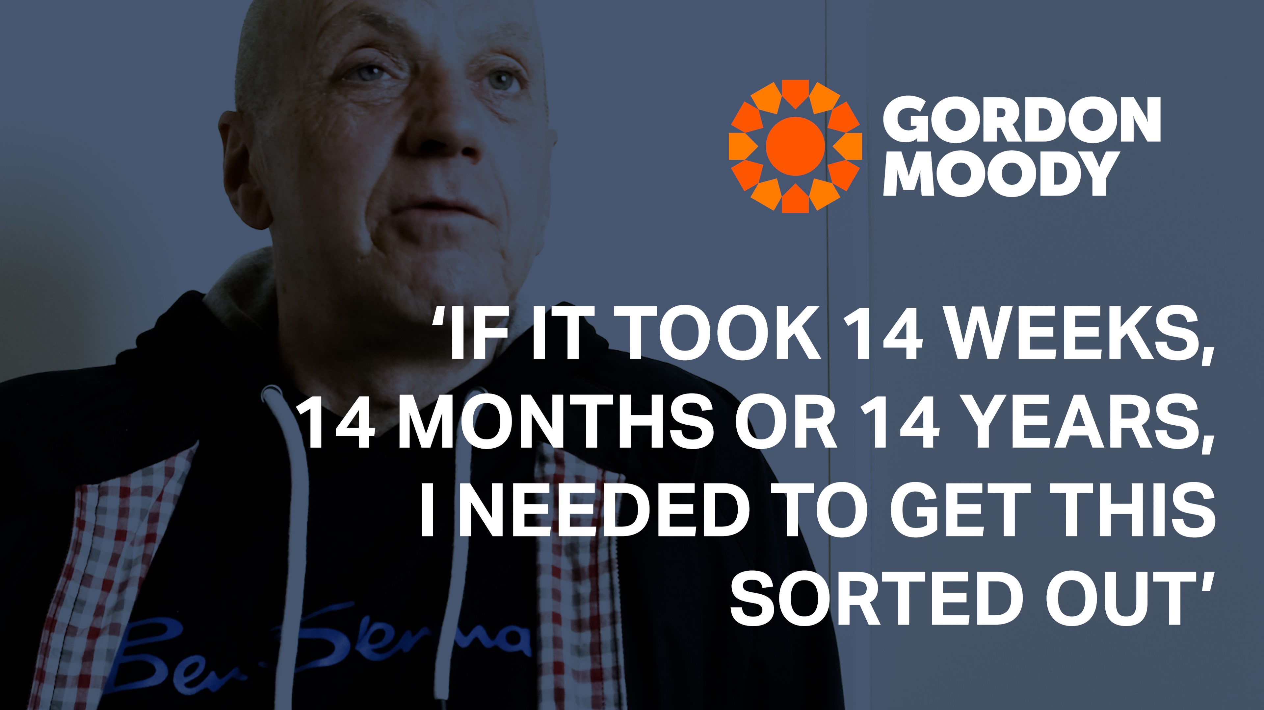

Slide 8
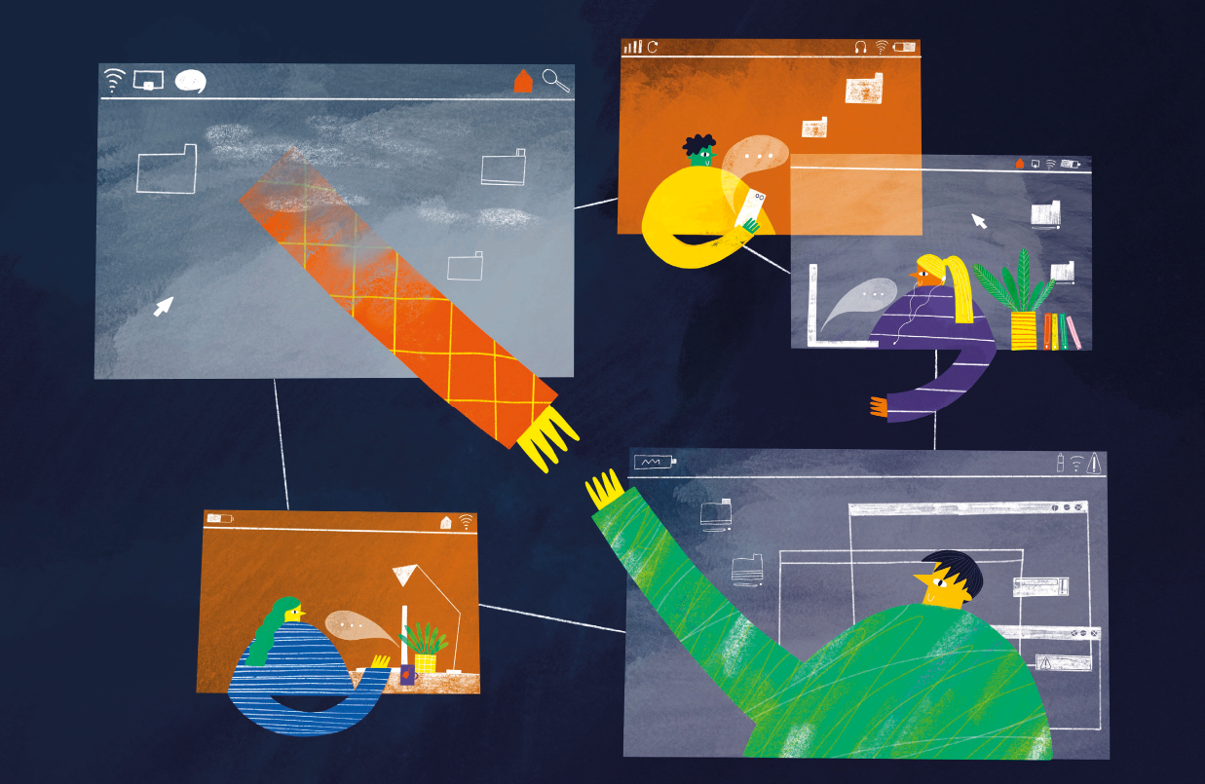
Our services
  We have 27 bedspaces for our 14-week men’s residential treatment programme across our locations in the UK.
  Our recovery housing has 18 bedspaces for those completing treatment but not quite ready for fully independent living.
  Our Retreat & Counselling Programme has 96 spaces a year for men and women unable to access the residential programme.
  Friends and family groups provide practical and emotional support to those with loved ones in treatment at Gordon Moody.
  Our Comfort Fund enables us to provide respite to families with a loved one in treatment.

Slide 10
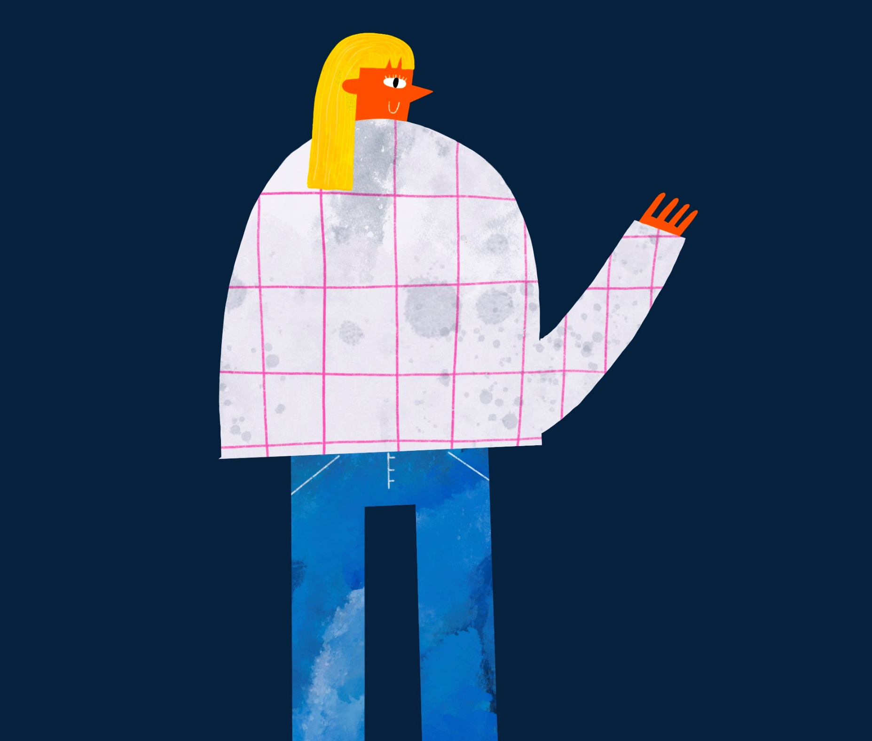
Unique women’s residential treatment
  We opened our new residential treatment centre specifically for women suffering from gambling addiction in November 2021.
  Set up after a surge in women needing residential support, with applications for treatment more than doubling in the last year.
  Five-week programme that addresses women’s relationship with gambling and also supports with trauma and mental health.
  Eight-week aftercare programme and continuous support for up to a year through our wrap-around services.
  Programme moved to a new site in July 2023, where capacity will increase by 60%.

Slide 11

WE HELP PEOPLE RECLAIM AND REBUILD THEIR LIVES FREE FROM GAMBLING ADDICTION

Slide 12
Applications
Applications
43%
INCREASE IN APPLICATIONS YEAR ON YEAR

Slide 13
Client complexity
Three in four applicants have contemplated suicide as a result of their gambling
One in two applicants have a diagnosed mental health condition
Over 40% of applicants have been involved with the criminal justice system
One in four applicants have used illicit substances
One in five applicants are assessed as medium to high risk in terms of their alcohol use
*Alcohol misuse is deemed to be a client with an audit score of 10+ and/or deemed to be of a medium to high risk.

Slide 14

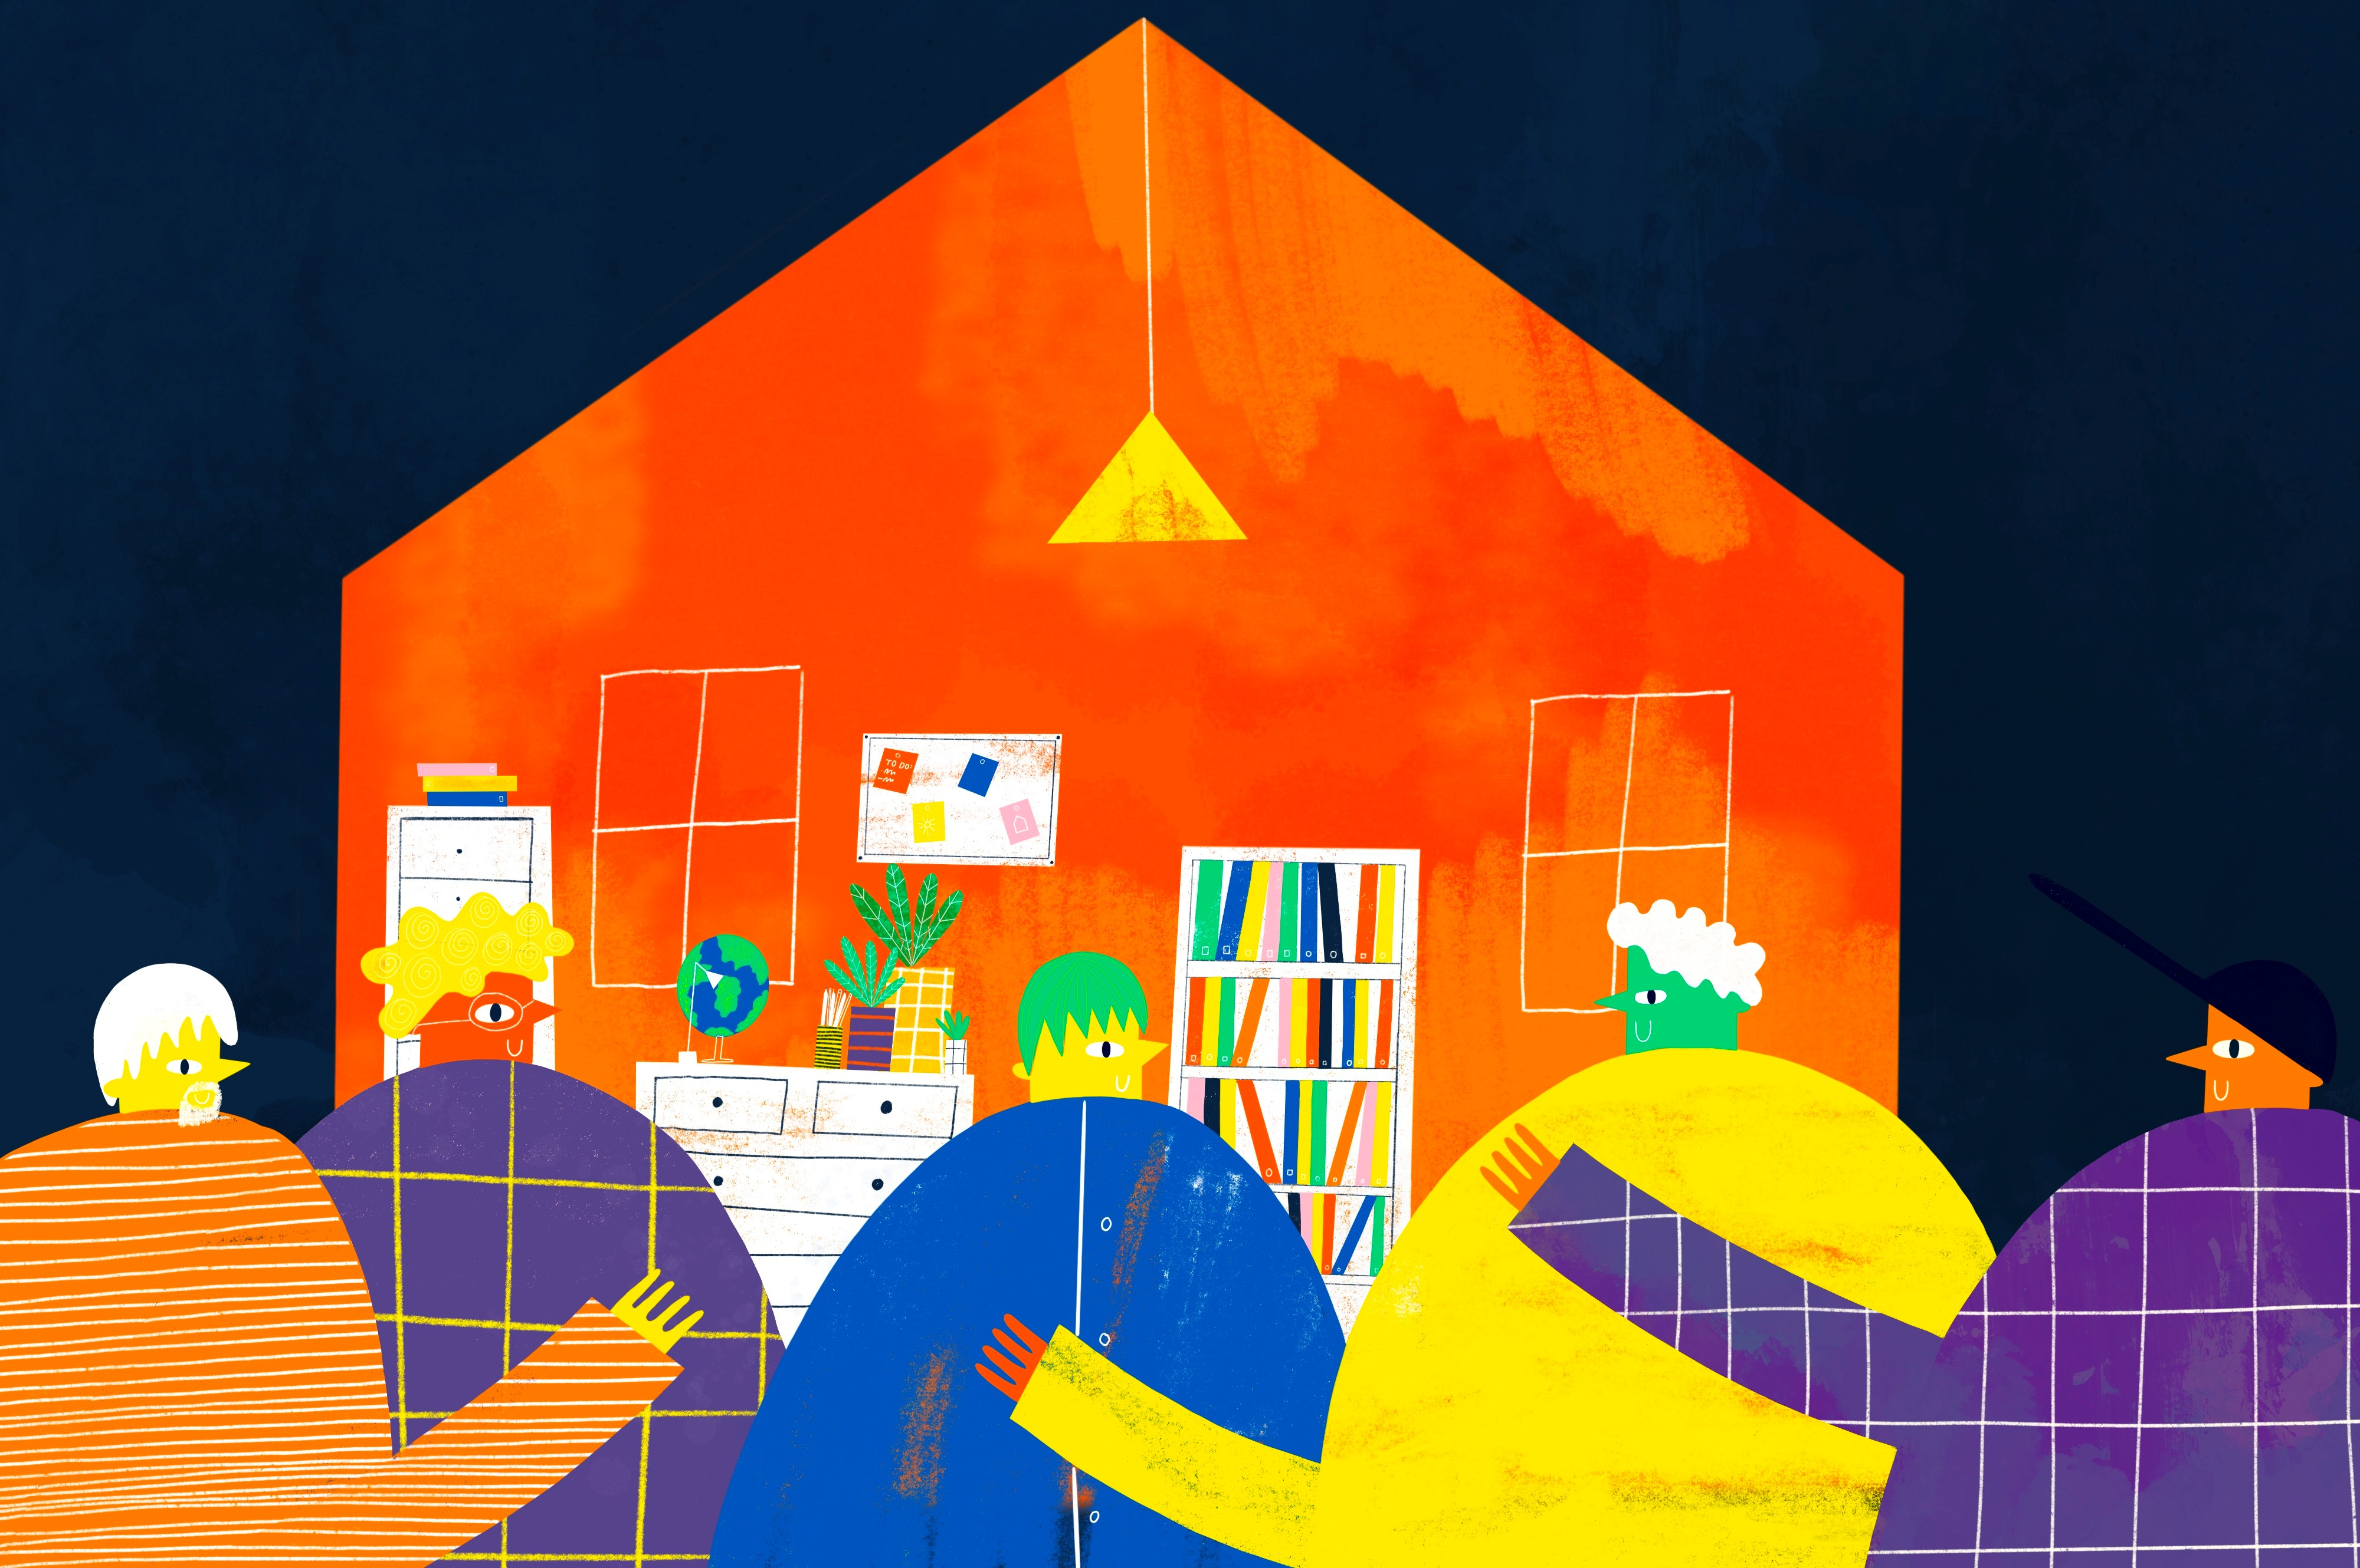
Greater accessibility
Two men’s residential programmes
Women’s residential programme
Enhanced residential programme
Eight Retreat & Counselling cohorts per year
18 recovery house beds
270
Treatment spaces
2023

Slide 15
Quality service delivery
78% completed
residential treatment 2022/23
82%
of admissions
completed treatment
in 2022-2023
*2021-2022 78% of admissions
83% completed
Retreat & Counselling 2022/23

Slide 16
Quality service delivery
17 AVERAGE PGSI IMPROVEMENT
AFTER RESIDENTIAL TREATMENT 2022

Slide 17
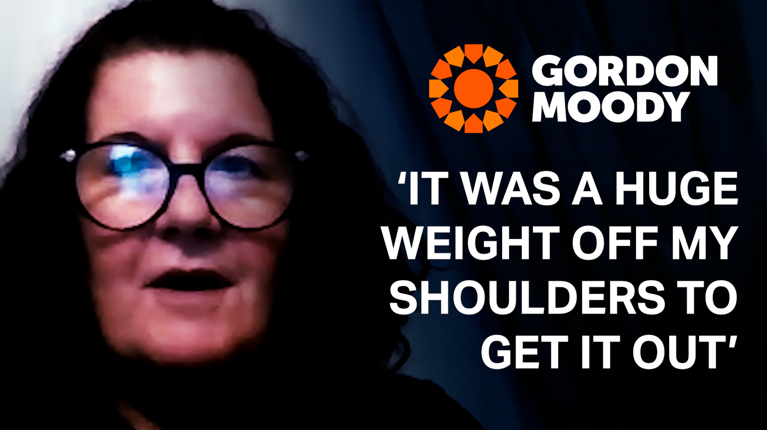

Slide 18
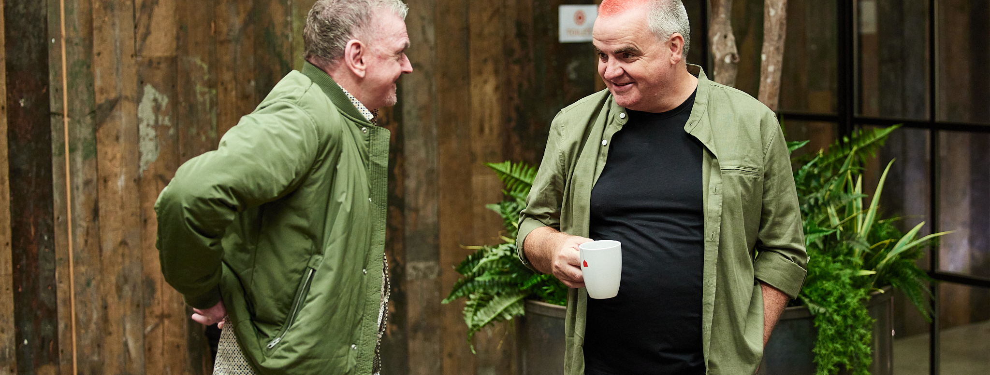
RISE.
SHINE.
RECOVER.

